Slide 1
XAML Controls Developer’s Guide to Windows 10

Slide 2
Controls in the XAML toolbox

Slide 3
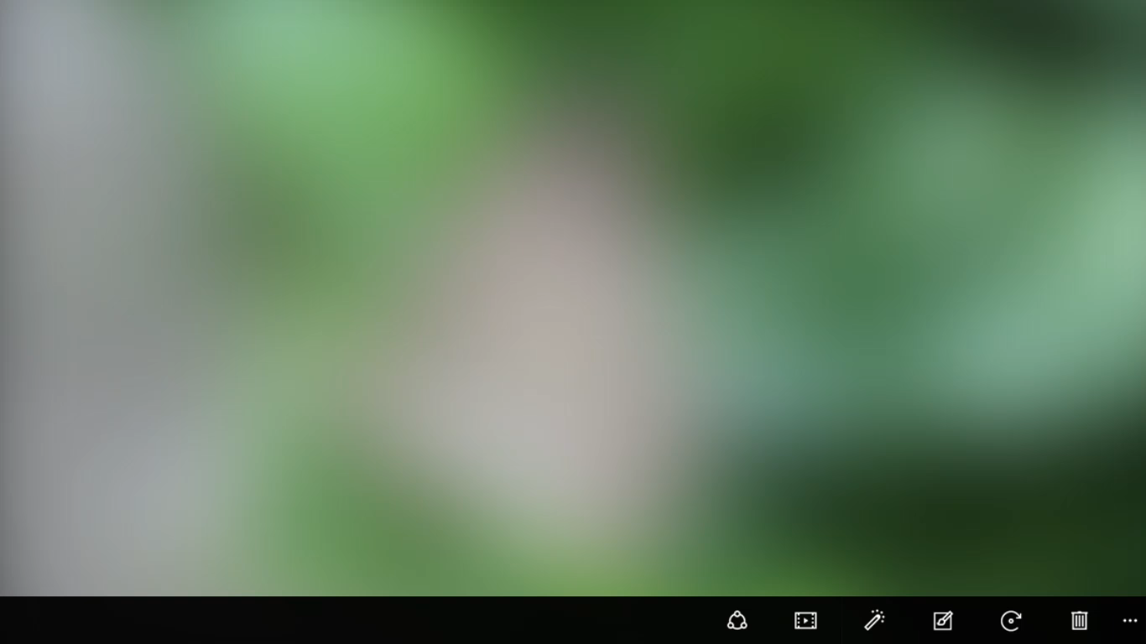

Adaptive controls

Slide 4


Input intelligence

Slide 5
Using standard controls gets you a long way

Slide 6
Layout controls
Windows XAML layout controls
Stack Panel
Canvas
Scroll Viewer
Border
Grid
View Box
Wrap Grid
Relative Panel

Slide 7
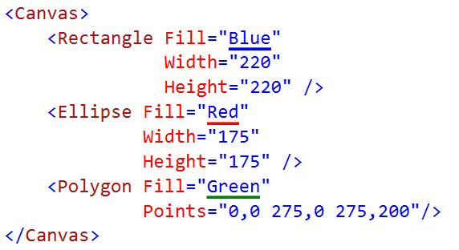
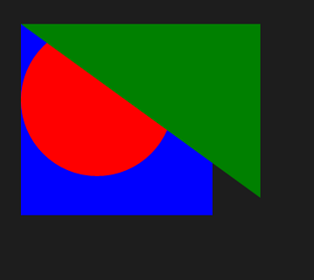
Canvas

Slide 8
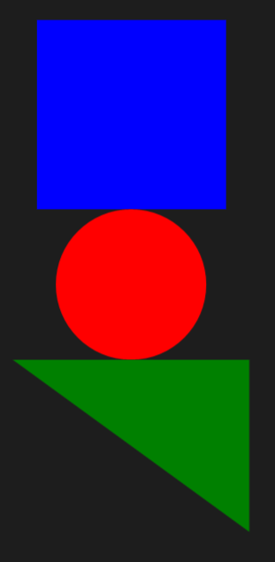
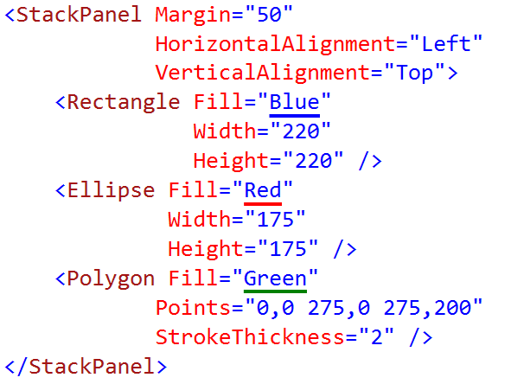
StackPanel

Slide 9
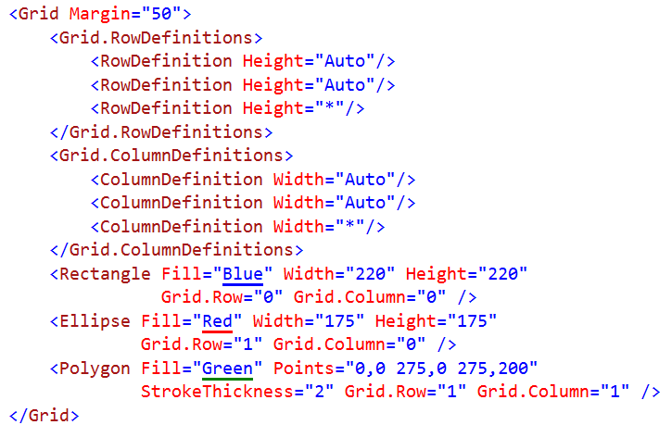
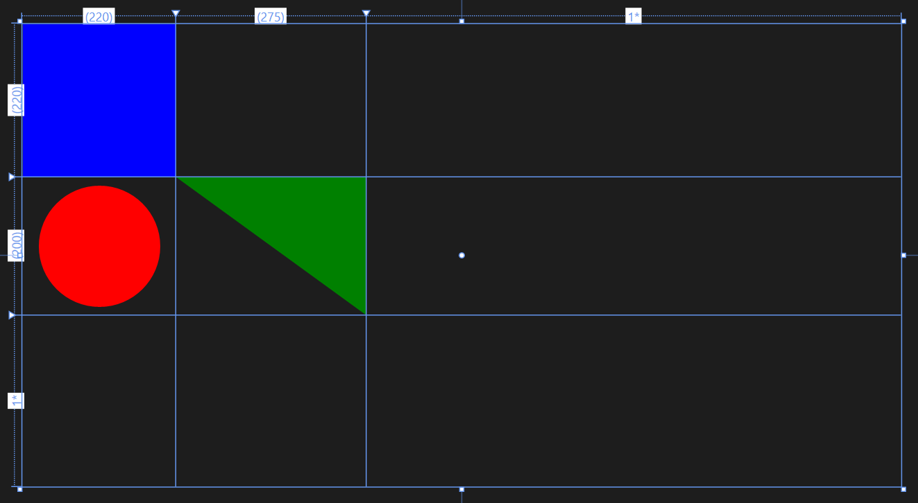
Grid

Slide 10
Proportional layout with Grid
2*
1*
auto
Rows/columns – 3 types of sizing:
star sizing
proportional: 1*/3* = 25%/75%
auto sizing
sized to content
content can also have Max/Min widths and heights as limits
pixel sizing
hard-coded size – avoid in most situations
7*
auto
4*
1*
Notes:
The biggest helper in all of this is the grid. Everyone has seen a layout control like this at some point – you define rows and columns and you size them as being either sized to content, proportionately sized or you can give them explicit sizes in (view) pixels.

Slide 11
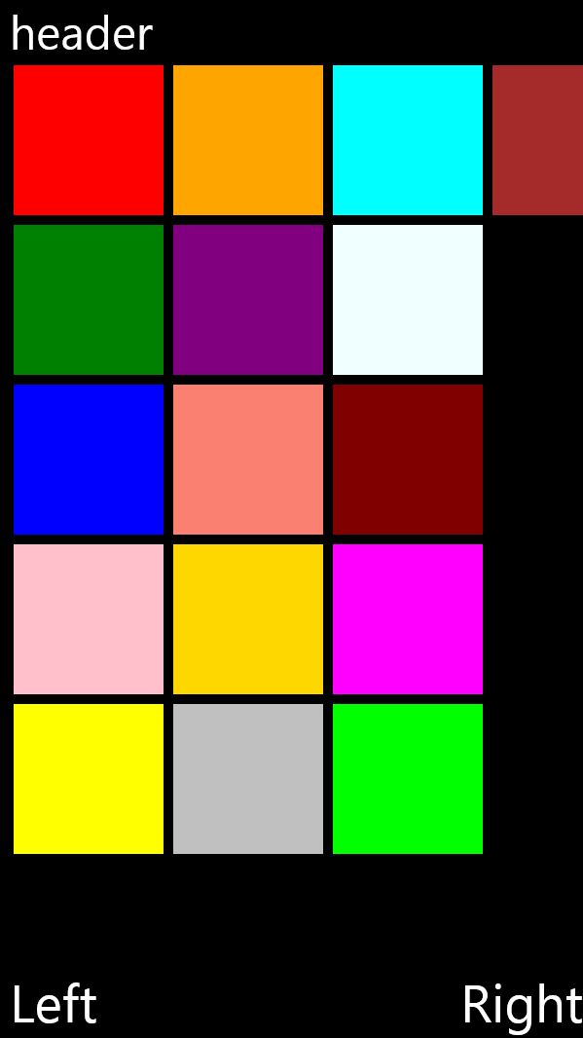
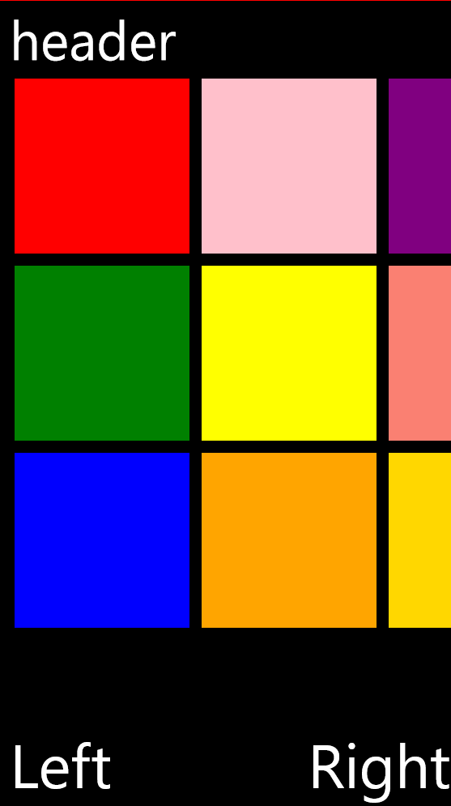
Proportional layout with Grid
600
Grid
400
auto
711
1*
1067
Grid
1*
1*
auto
Notes:
Simple example. We’ve built this little layout with a GridView control in the middle and we’ve got all content such that it will fill all horizontal space but the GridView control is placed inside a “star sized” grid row so at the point where we move to a bigger device like the 600x1067 device on the right that GridView is going to get both more horizontal and vertical pixels to play with and it’s going to display more content because of it.
The content in the 2 rows at the top/bottom of the screen is “auto” sized because it doesn’t need to get bigger as the device gets bigger (i.e. if we assume it was already readable/interactive at the size it is on the 400x711 device then the system will make sure it’s good for the 600x1067 device too).

Slide 12
Demo: Layout with Grid

Slide 13
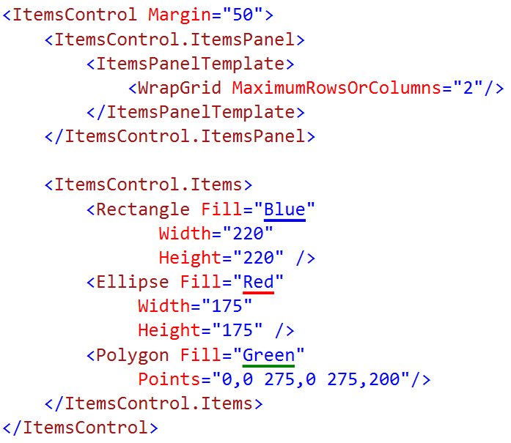
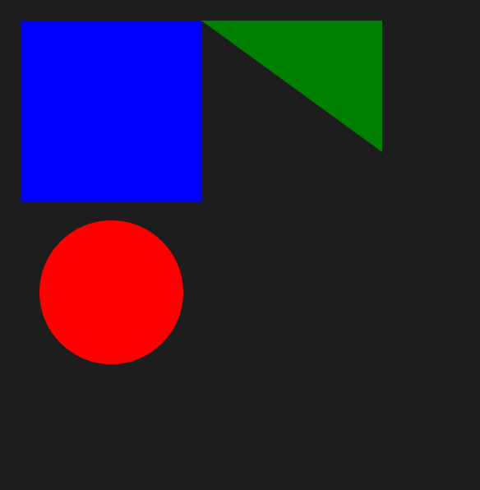
WrapGrid

Slide 14
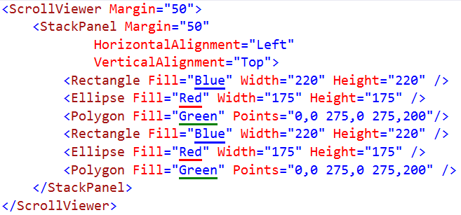
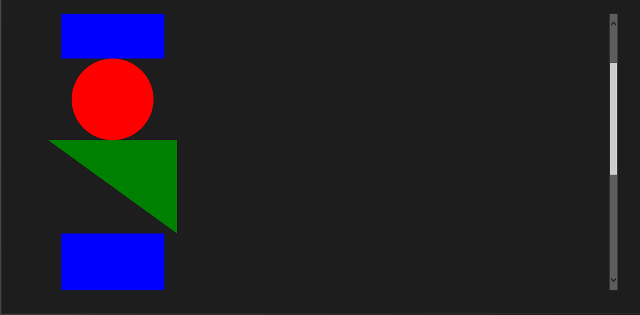
ScrollViewer

Slide 15
Introducing the Relative Panel
Windows XAML layout controls
Stack Panel
Canvas
Scroll Viewer
Border
Grid
View Box
Relative Panel
Wrap Grid
Relative Panel is a XAML layout control. It arranges children by declaring relationships between them.

Slide 16
XAML's RelativePanel control
A child or two act as a anchor elements
They are relative to the panel
Other children are relative to the anchors
RelativePanel.Above = "ElementName"
RelativePanel.RightOf = "ElementName"
RelativePanel.Below = "ElementName"
RelativePanel.LeftOf = "ElementName"
RelativePanel simplifies adaptive UI
A simple Visual State setter can rearrange the UI
One element can move a family of related element

Slide 17
Align with panel
<RelativePanel>
<Rectangle x:Name="RedRect" Height="100" Width="100" Fill="Red"
RelativePanel.AlignHorizontalCenterWithPanel="True" RelativePanel.AlignVerticalCenterWithPanel="True" />
<Rectangle x:Name="BlueRect" Height="100" Width="200" Fill="Blue" />
</RelativePanel>

Slide 18
Align with sibling (below, center)
<RelativePanel>
<Rectangle x:Name="BlueRect" Height="100" Width="100" Fill="Blue" />
<Rectangle x:Name="RedRect" Height="100" Width="100" Fill="Red"
RelativePanel.Below="BlueRect" RelativePanel.AlignHorizontalCenterWith="BlueRect" />
</RelativePanel>

Slide 19
Demo: RelativePanel

Slide 20
SplitView
 | IsPaneOpen="True" | IsPaneOpen="False"
DisplayMode= "Inline"
DisplayMode= "Overlay"
DisplayMode= "CompactInline"
DisplayMode= "CompactOverlay"

Slide 21
Demo: SplitView

Slide 22
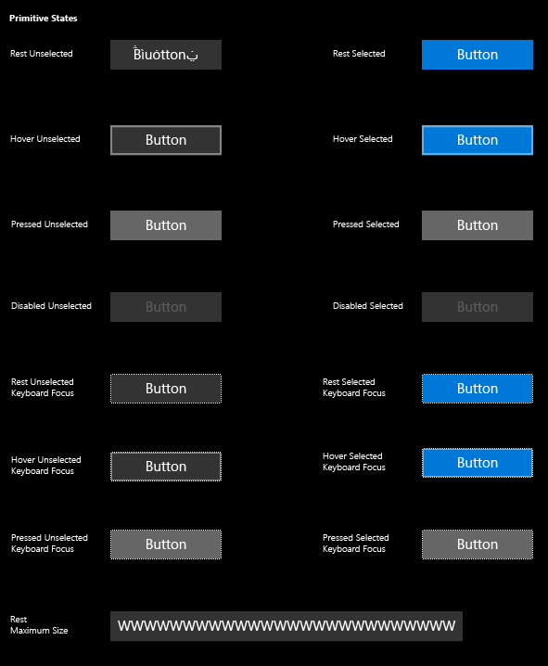
Buttons
<Button Content="" />
<HyperlinkButton />
<RepeatButton />
<ToggleButton IsChecked="" />

Slide 23
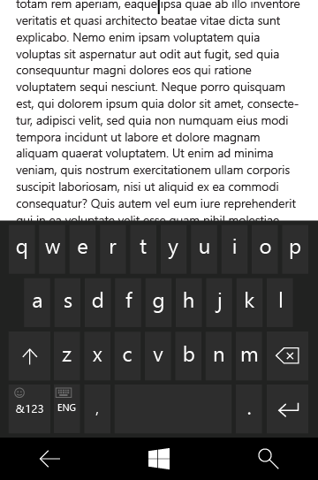
Text controls
<TextBox Text="" />
<PasswordBox Text="" />
<TextBlock Text="" />
<RichEditBox Content="" />
<RichTextBlock Content="" />
<BitmapIcon UriSource="" />
<FontIcon Glyph="" />
<SymbolIcon Icon="" />
<PathIcon Data="" />

Slide 24
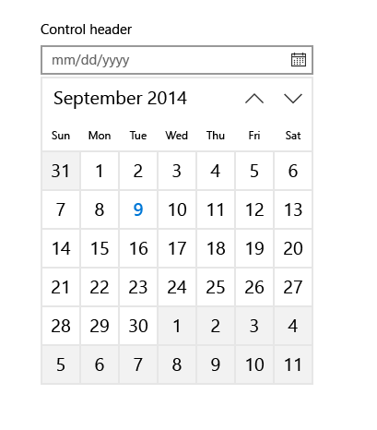
Selection and picker controls
<CalendarView />
<DatePicker Date="" />
<TimePicker Time="" />
<ToggleSwitch IsChecked="" />
<CheckBox IsCHecked="" />
<RadioButton IsChecked="" />
<ComboBox />
<ListBox />
<Slider Minimum="" Maximum="" />

Slide 25
Collection/data controls
<ItemsControl ItemsSource="" />
<FlipView />
<GridView />
<ListView />
<SematicZoom />
<Hub Orientation="" />
<ContentControl ControlTemplate="" />
<DataTemplate />
<ItemsPanelTemplate />
<ControlTemplate />
<ContentPresenter />
<ItemsPresenter />
<ContentControl />

Slide 26
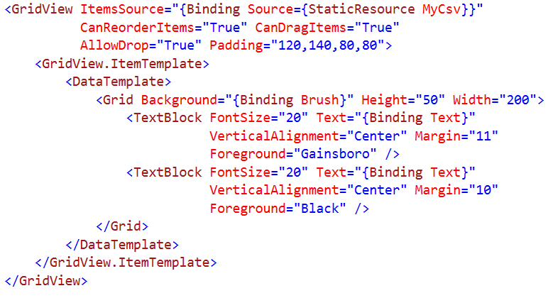
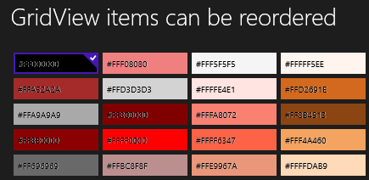
Grid View Syntax

Slide 27
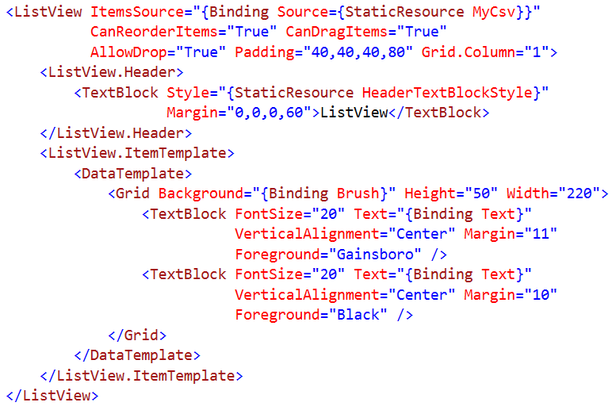
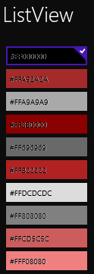
List View Syntax

Slide 28
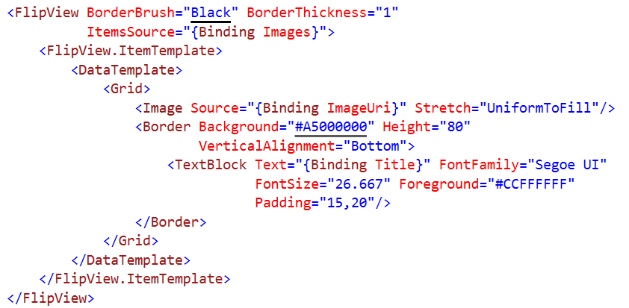

Flip View Syntax

Slide 29
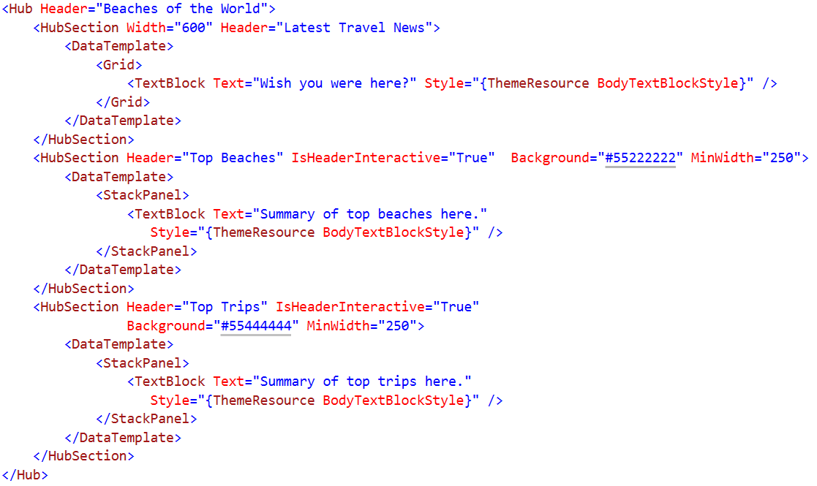
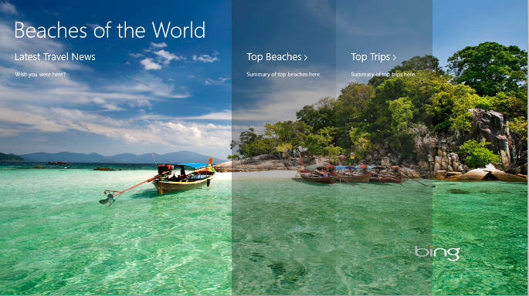
Hub Syntax

Slide 30
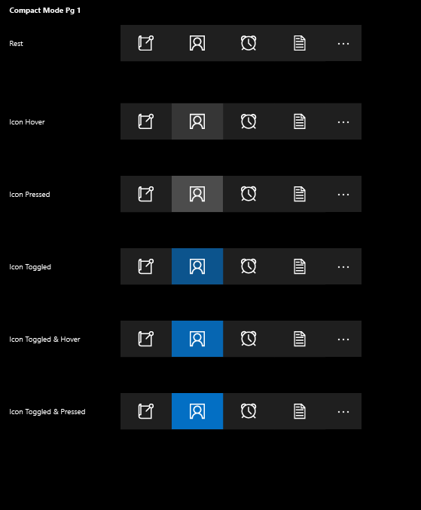
App bars and commands
<AppBar />
<CommandBar />
<AppBarButton Label="" Icon="" />
<AppBarToggleButton IsChecked="" />
<AppBarSeparator />

Slide 31
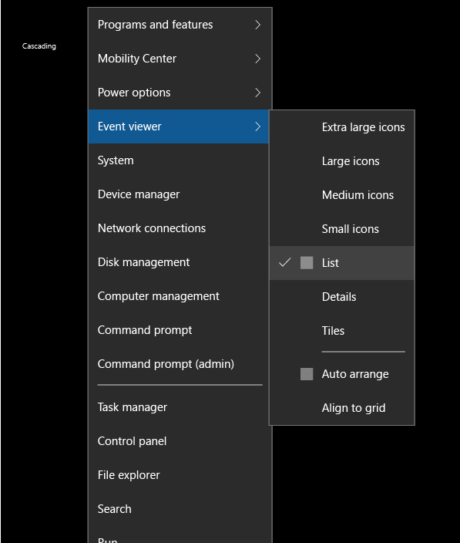
Flyout controls
<Popup IsOpen="" />
<ContentDialog Title="" Content="" />
<Flyout Placement="" />
<MenuFlyout />
<ToolTip />

Slide 32
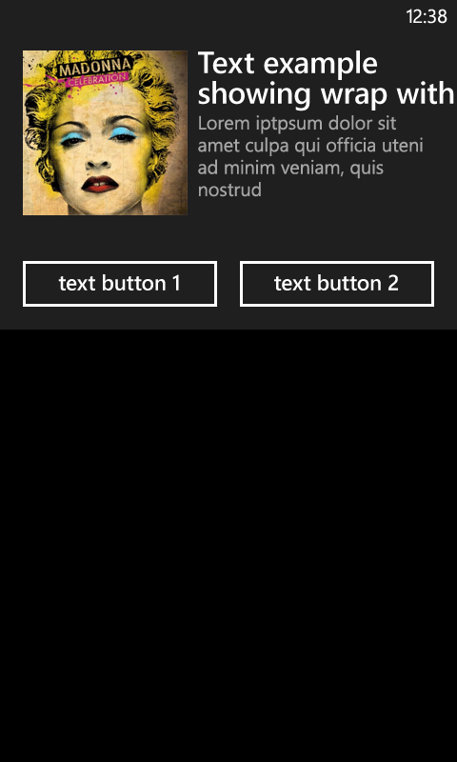
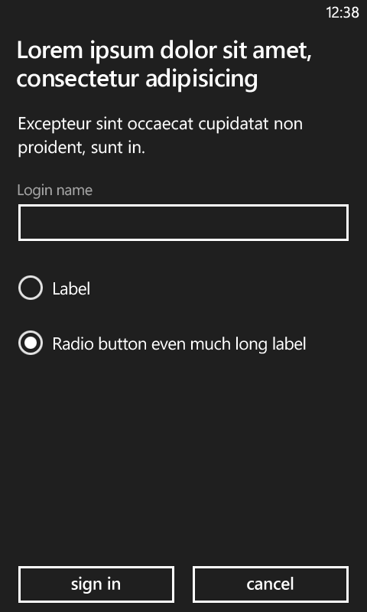
ContentDialog
A custom message box to place arbitrary content
Supports both full and partial screen

Slide 33
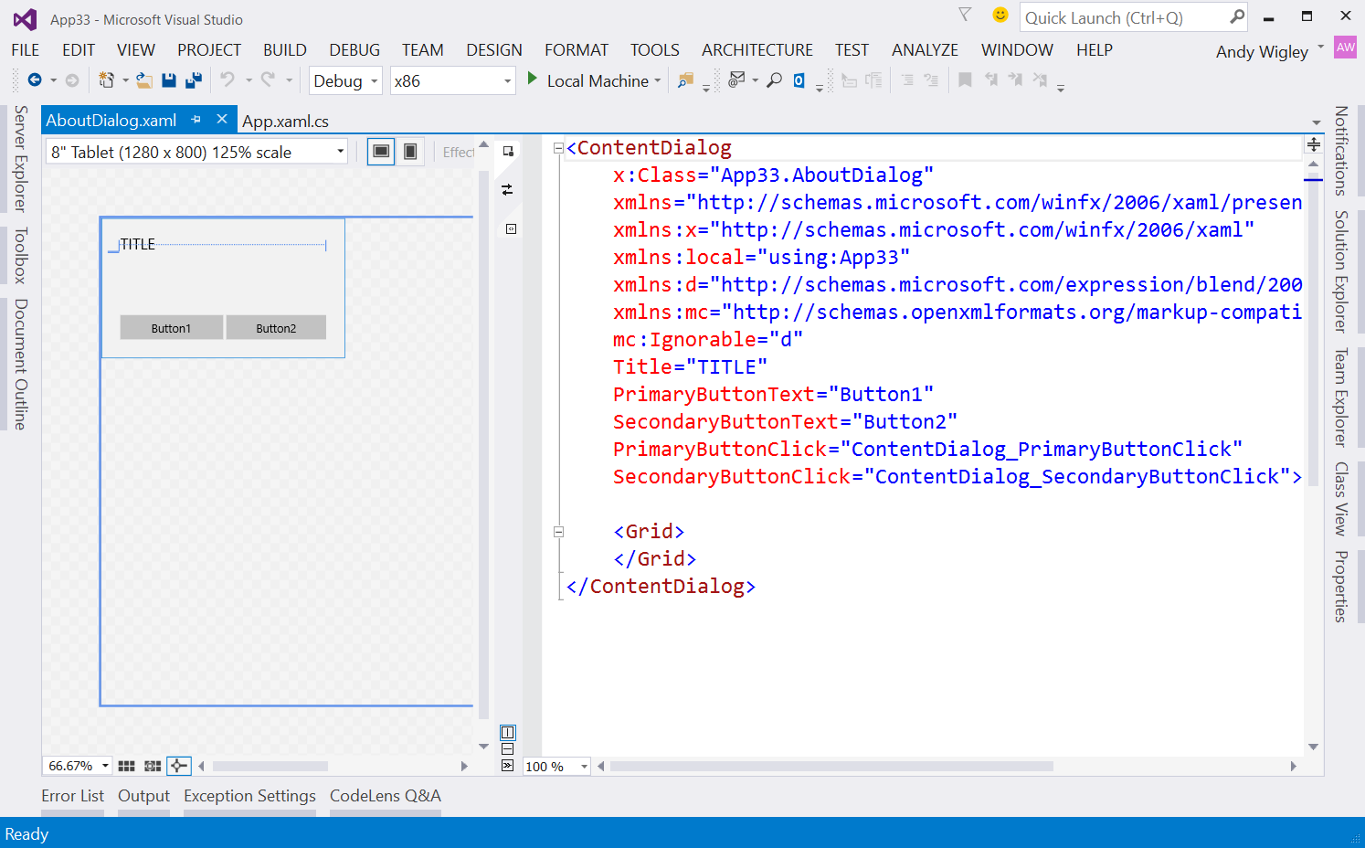
ContentDialog in XAML
Project -> ‘Add New Item’ -> select ContentDialog
Design your ContentDialog in the same way as a User Control
In code, show your dialog like this:
AboutMessage myDialog = new AboutMessage();
ContentDialogResult result = await myDialog.ShowAsync();
if (result == ContentDialogResult.Primary) { /* do some more Primary logic */ }
else if (result == ContentDialogResult.Secondary)
{ /* else do Secondary logic */ }

Slide 34
Demo: Flyout controls

Slide 35
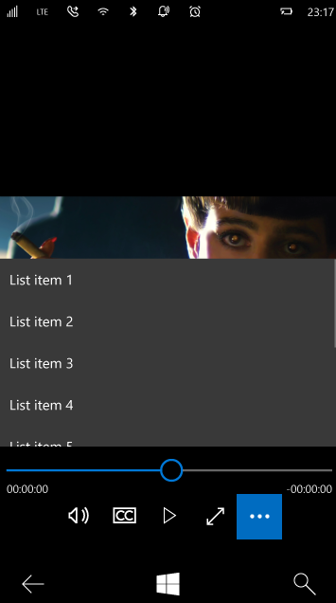
Progress, Media & Inking controls
<ProgressBar IsIntermediate="" />
<ProgressRing IsActive="" />
<Image />
<InkCanvas />
<MediaElement />
<CaptureElement />

Slide 36
Resources and Styles

Slide 37
What is a XAML resource?
System resources
ThemeResources
Custom resources
Values (like font size)
Objects (like color brushes)
Control styles
BasedOn
Templates
Control templates
Data templates

Slide 38
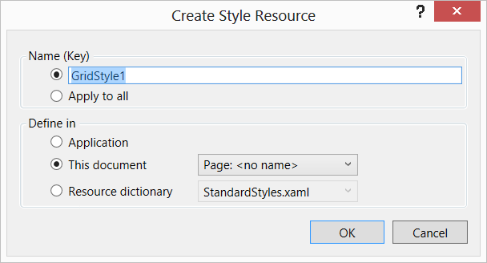
Resource Scope

Slide 39
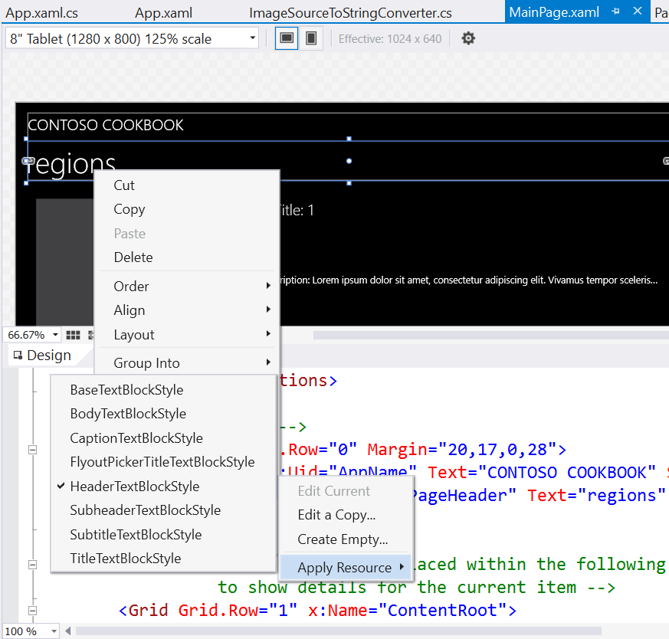
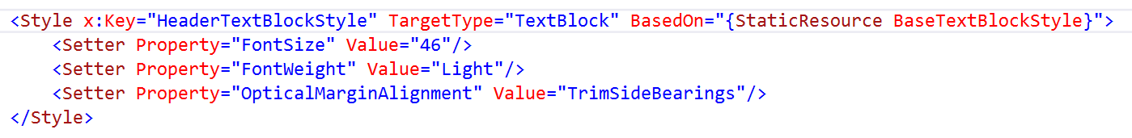
Style Resources for TextBlock
A limited set of Style resources are supplied in the SDK
Suitable for common text display scenarios
Use F12 to examine style definition
You can create your own styles
Use BasedOn to base on a supplied style
Set your own Property Values
Define in App.xaml or in the Page resources
Notes:
The SDK includes a set of styles you should use for styling the text you display in TextBlock controls and other control templates that incorporate TextBlock controls, such as Pivot headers.
You can use any of the supplied styles by right-clicking on a control in the XAML Designer, then click ‘Edit Style’ -> ‘Apply Resource’ then select the style you want.
You can examine the definition of any style: click on the style name where you have applied it to a control, then press the F12 key (or right-click and select ‘Go To Definition’). You can see that all the standard styles ‘inherit’ (i.e. they use the BasedOn attribute) from BaseTextBlockStyle.
You can create custom styles of your own that are based on any of the supplied styles, and define them in your App.Xaml in <Application.Resources>…</Application.Resources> to use them throughout your app, or in the Page resources to use them just in a Page.

Slide 40
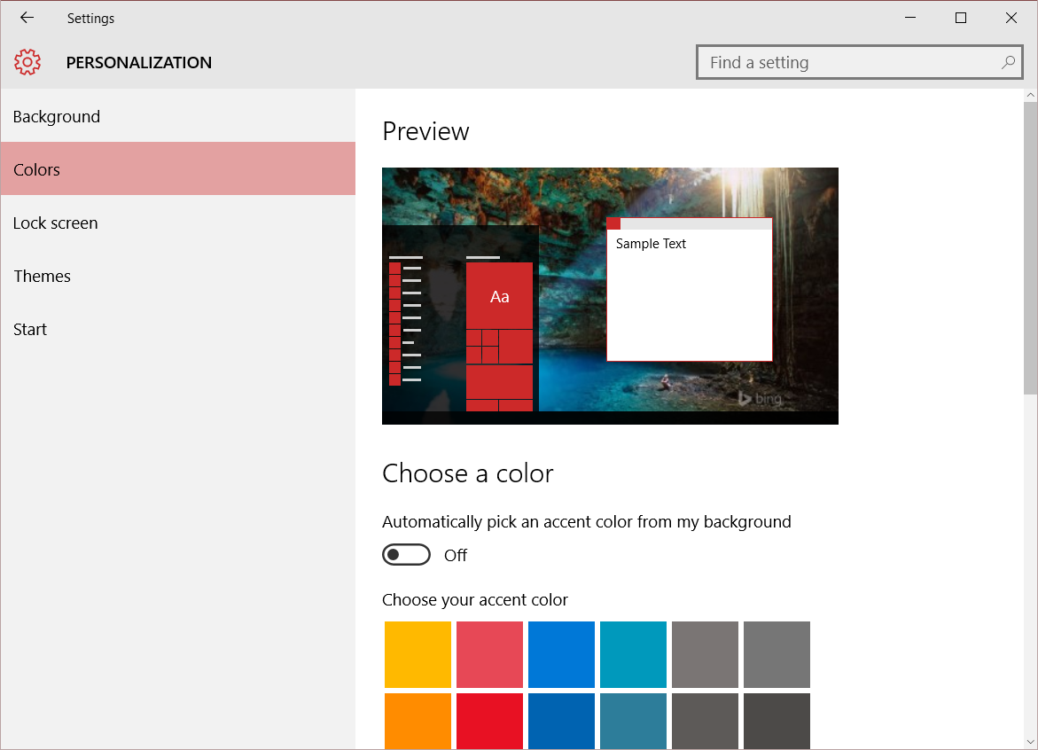
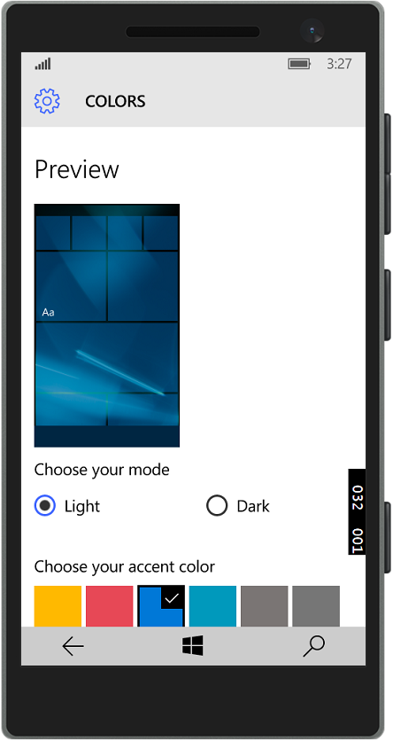
User theme and contrast preferences
On Windows 10, users can select an accent color
You can use this color like this:
On Windows 10 Mobile, also can select Light or Dark mode
Unlike Windows Phone 8.1, your app does not automatically apply the Light or Dark theme
User can also select text size and/or High Contrast
Test your apps to respect these settings
<SolidColorBrush x:Key="AccentBrush" Color="{ThemeResource SystemAccentColor}"/>
Notes:
Many phone developers forget that Windows Phone users can select a light or dark theme for their phone, and select an accent color.
You should also be aware that users can select smaller or larger text size in Ease of Access settings.

Slide 41
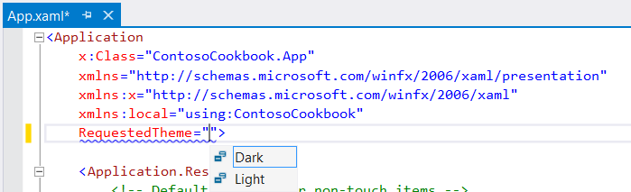
Requesting Light or Dark theme
Request the theme for your app in app.xaml:
You can also apply the RequestedTheme attribute to any Page or Control:
<StackPanel RequestedTheme="Light"> … </StackPanel>
Notes:
The framework provides you with the Dark and Light themes.
In Windows Phone XAML 8.1, you can change the theme used by your app in the RequestedTheme element in your App.xaml, or maybe in your App constructor.
It’s called RequestedTheme because it’s not an absolute theme because of High Contrast used for Accessibility – High Contrast will always take preference over RequestedTheme.
The Dark and Light RequestedThemes do not only have to be applied at the app level. RequestedTheme may also be applied to any element in the tree. So you can set it and that element and any of its children will take on the requested theme.

